Slide 1
ANALYSIS FOR UNIVERSITY
MENU
ANALYSIS
CONTACT
UNIVERSITY TRENDS
DATA
The HackerStreet Boys

Slide 2


MENU
ANALYSIS
CONTACT
UNIVERSITY TRENDS
OUR TEAM
Benfenati domenico
Carandente vincenzo
Master’s Degree in Computer Engineering at the Federico II University of Naples
Master’s Degree in Computer Engineering at the Federico II University of Naples

Slide 3
TABLE OF CONTENT
Problem statement
Data collecting
01
02
Data cleaning
Data analysis
03
04
MENU
ANALYSIS
CONTACT
UNIVERSITY TRENDS
What business problem am I trying to solve?
What kind of data I need for analysis?
What are the most important data among those collected?
What can I say about this data?

Slide 4
Problem statement
01
MENU
ANALYSIS
CONTACT
UNIVERSITY TRENDS
Understand business and business goals

Slide 5
Problem statement
MENU
ANALYSIS
CONTACT
UNIVERSITY TRENDS
The various analysis are oriented to the research of trends related to the
enrollment of students in the different courses of study, based on demography, background and employment opportunities

Slide 6
pros VS cons
Lots of data
low Information
MENU
ANALYSIS
CONTACT
UNIVERSITY TRENDS
You have a large amount of data, all useful for different purposes…
VS
… but not all of it contains interesting information to analyse

Slide 7

METHODS, TECHNIQUES AND TOOLS
MENU
ANALYSIS
CONTACT
UNIVERSITY TRENDS
The process was based on three fundamental steps:
Identify the state of the art
Predict data trends
Find ways to manipulate what will be

Slide 8






METHODS, TECHNIQUES AND TOOLS
MENU
ANALYSIS
CONTACT
UNIVERSITY TRENDS
Google Colab
Pandas
Excel
PowerBI
Folium

Slide 9
data collection
02
MENU
ANALYSIS
CONTACT
UNIVERSITY TRENDS
Collecting and aggregate data

Slide 10

Data sources
Third-party data
MENU
ANALYSIS
CONTACT
UNIVERSITY TRENDS
Quantitative data
Open datasets owned by organizations such as MIUR and ISTAT
Numerical values concerning percentages and absolute values of enrolled students, graduates, etc.

Slide 11


DATA collection
MENU
ANALYSIS
CONTACT
UNIVERSITY TRENDS
Open data
Not only data on students, but also territory and demography
Gathering of the most interesting collections
Time series of all kinds concerning enrolments, graduates, etc.

Slide 12
data cleaning
03
MENU
ANALYSIS
CONTACT
UNIVERSITY TRENDS
Delete superfluous data

Slide 13
Data cleaning process
MENU
ANALYSIS
CONTACT
Filter errors
01
02
Remove unwanted
Removing errors, duplicates or outliers
Filter the observations that have no bearing for the analysis
Filling in
04
03
Bringing structure
If exists some gaps, fill it with other data
Fixing typos and layout issues

Slide 14
data analysis
04
MENU
ANALYSIS
CONTACT
UNIVERSITY TRENDS
Extraction of the information from data

Slide 15


TYPES OF DATA ANALYSIS
DESCRIPTIVE
DIAGNOSTIC
PREDICTIVE
MENU
ANALYSIS
CONTACT
UNIVERSITY TRENDS
PREscripTIVE
Identifies what has already happened
Understanding why something has happened
Identifies future trends based on historical data
Make some raccomandation for the future

Slide 16
Some numbers
MENU
ANALYSIS
CONTACT
UNIVERSITY TRENDS
universities
35
98
in southern Italy only
25
universities
universities
now active in Italy
have a catchment area of more than 20,000 students

Slide 17
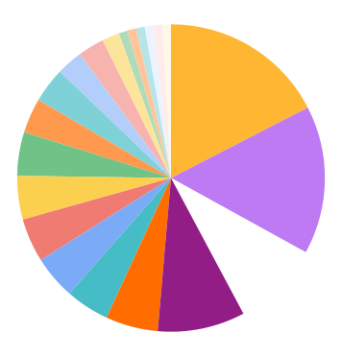
Region per universities
MENU
ANALYSIS
CONTACT
UNIVERSITY TRENDS
17.4%
15.6%
Lazio is the region with most universities
Lombardy is the second for universities
9.2%
9.2%
Campania ranks 4th for number of universities
Tuscany is the third, tie with Campania

Slide 18
Quantity
MENU
ANALYSIS
CONTACT
UNIVERSITY TRENDS
…but
quality

Slide 19
490.000
MENU
ANALYSIS
CONTACT
UNIVERSITY TRENDS
3,
..and more students enrolled since 2010

Slide 20
Region enrollment
MENU
ANALYSIS
CONTACT
UNIVERSITY TRENDS
The percentages are calculated according to the population of the region
3% to 4%
Less than 2.5%
More than 4%
2.5% to 3%

Slide 21
What kind of factor influence region enrollment?
MENU
ANALYSIS
CONTACT
UNIVERSITY TRENDS
.
Employment status?
Territorial features?
Family background?

Slide 22
diagnostic analysis
MENU
ANALYSIS
CONTACT
UNIVERSITY TRENDS

Slide 23
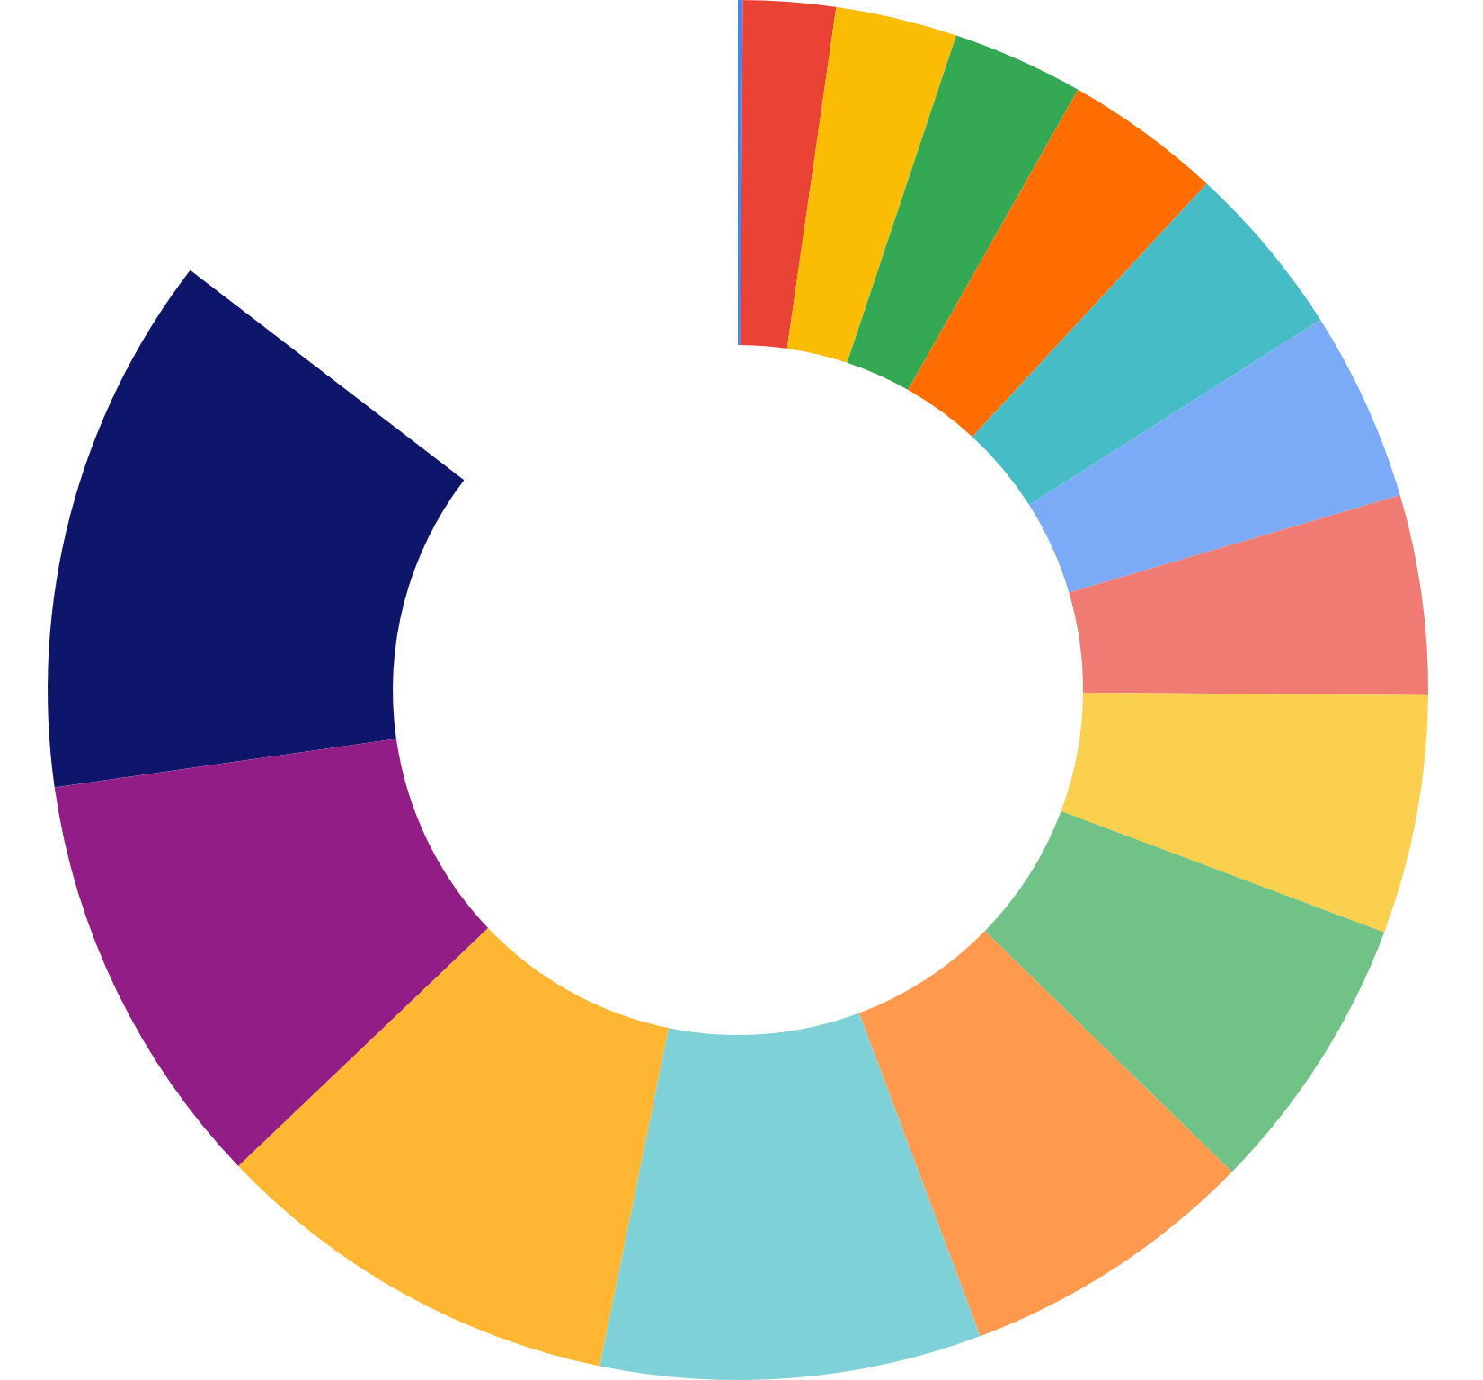
Group enrollment
MENU
ANALYSIS
CONTACT
UNIVERSITY TRENDS
12.7%
14.6%
choose engineering branch
choose economic-statistical branch
enroll to legal branch
9.9%
choose political-social branch
10.9%
Source: ISTAT

Slide 24
50%
MENU
ANALYSIS
CONTACT
UNIVERSITY TRENDS
…but the total number of groups are sixteen !
These four groups alone comprise almost
of students enrolled since 2010.
Why do they choose them?

Slide 25
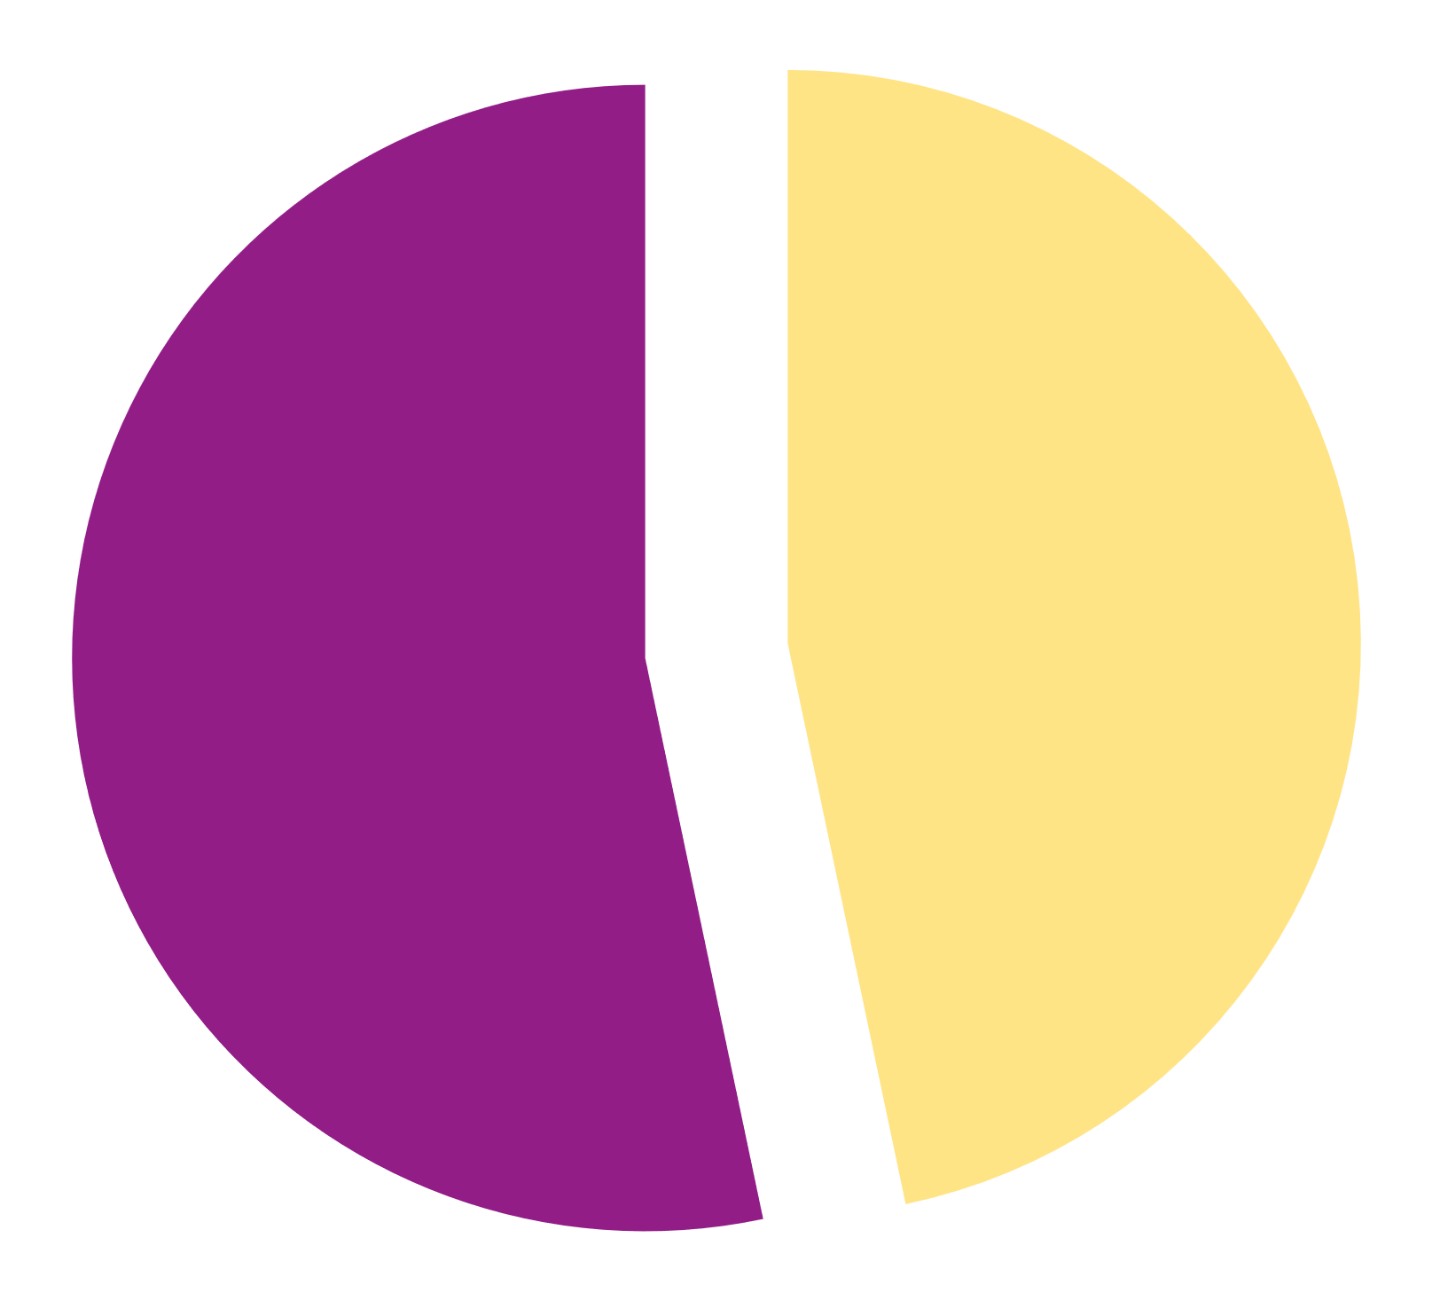
Graduates family background
MENU
ANALYSIS
CONTACT
UNIVERSITY TRENDS
46.7%
of students with parents with a university degree, on the other hand, manage to obtain a bachelor's degree
53.3%
of students with graduate parents manage to obtain a second level degree
… but what if the family background changes?

Slide 26
predictive analysis
MENU
ANALYSIS
CONTACT
UNIVERSITY TRENDS

Slide 27
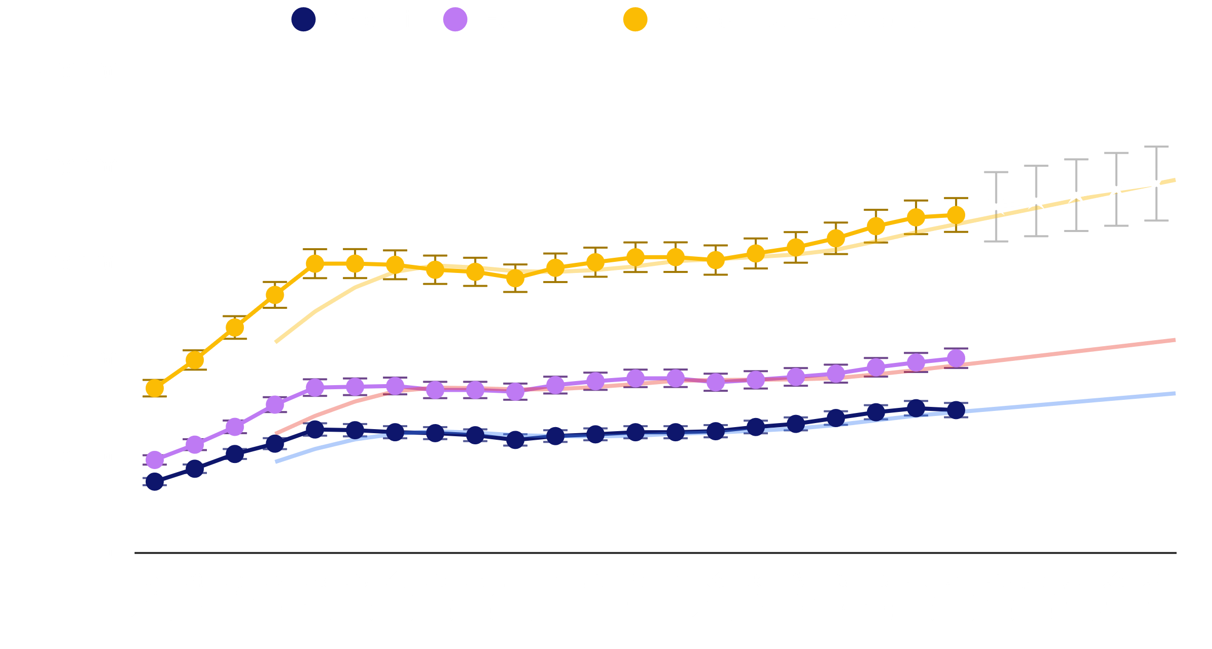
What about the future?
MENU
ANALYSIS
CONTACT
UNIVERSITY TRENDS

Slide 28
prescriptive analysis
MENU
ANALYSIS
CONTACT
UNIVERSITY TRENDS

Slide 29
data visualization
MENU
ANALYSIS
CONTACT
UNIVERSITY TRENDS

Slide 30
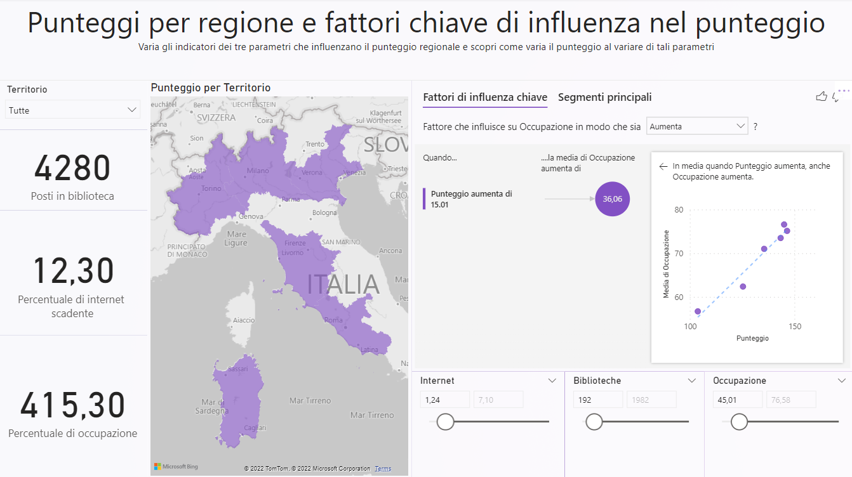
powerBI dashboard
MENU
ANALYSIS
CONTACT
UNIVERSITY TRENDS
In order to make the analysis more readable, it was decided to create dashboards using PowerBI

Slide 31
THANKS!
MENU
ANALYSIS
CONTACT
UNIVERSITY TRENDS
Do you have any questions?

